Slide 1
Learning Objective
I will be able to solve Exponential Equations
Success Criteria
At the end of the lesson, I will be able to:
Solve Exponential Equations

Slide 2
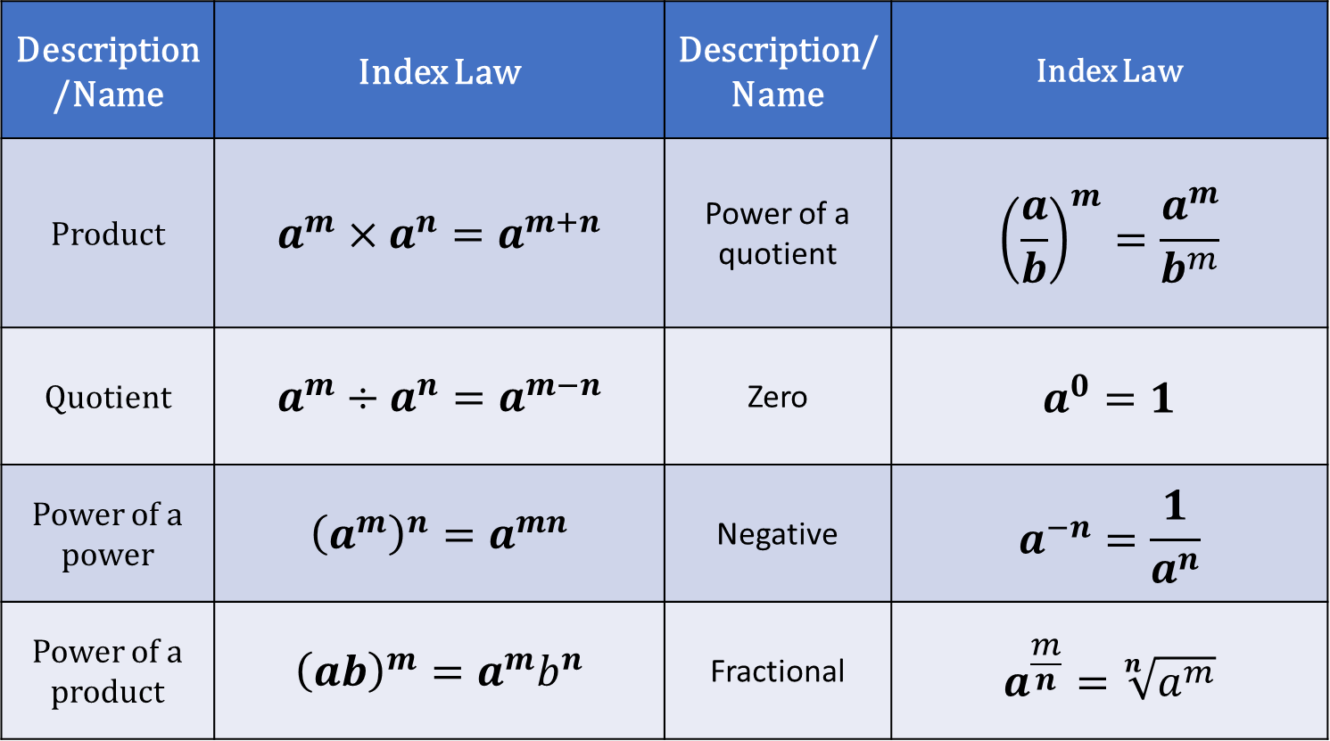
Activating Prior Knowledge
Index Laws
Description/Name | Index Law | Description/Name | Index Law
Product | $$a^{m}×a^{n}=a^{m+n}$$ | Power of a quotient | $${\left(\frac{a}{b}\right)}^{m}=\frac{a^{m}}{b^{m}}$$
Quotient | $$a^{m}÷a^{n}=a^{m−n}$$ | Zero | $$a^{0}=1$$
Power of a power | $${\left(a^{m}\right)}^{n}=a^{mn}$$ | Negative | $$a^{−n}=\frac{1}{a^{n}}$$
Power of a product | $${\left(ab\right)}^{m}=a^{m}b^{n}$$ | Fractional | $$a^{\frac{m}{n}}=\sqrt[n]{a^{m}}$$
Note: These laws applies to all integers $m$ and $n$ and non-zero numbers $a$ and$b$.

Slide 3
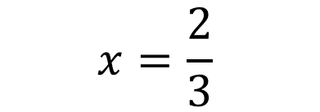
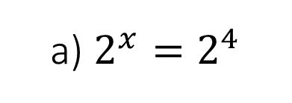

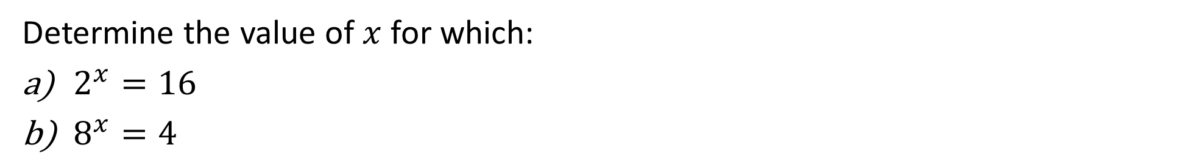
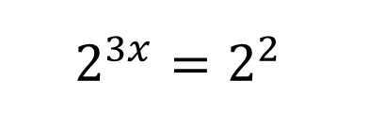
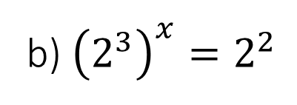

Activating Prior Knowledge
Determine the value of $x$ for which:
$2^{x}=16$
$8^{x}=4$
Express both in terms of the same base
Compare indices
a) $2^{x}=2^{4}$
b) ${\left(2^{3}\right)}^{x}=2^{2}$
$$x=4$$
$$2^{3x}=2^{2}$$
$$3x=2$$
$$x=\frac{2}{3}$$

Slide 4


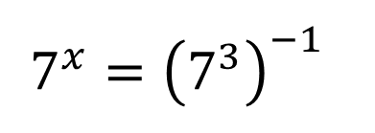

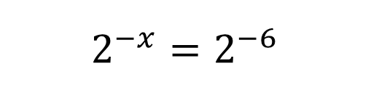
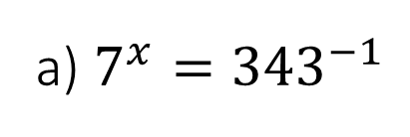
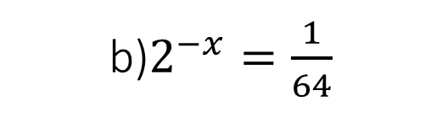
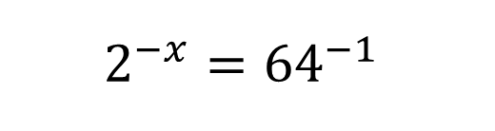

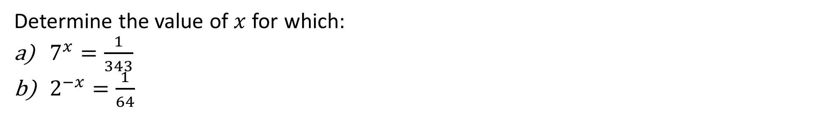


Guided Practice
Determine the value of $x$ for which:
$7^{x}=\frac{1}{343}$
$2^{−x}=\frac{1}{64}$
a) $7^{x}={343}^{−1 }$
b)$2^{−x}=\frac{1}{64}$
$$7^{x}={\left(7^{3}\right)}^{−1 }$$
$$\frac{1}{2^{x}}=\frac{1}{64}$$
$$2^{−x}={64}^{−1}$$
$$7^{x}=7^{−3}$$
$$2^{−x}=2^{−6}$$
$$2^{x}=2^{6}$$
$$x=−3$$
$$x=6$$
$$x=6$$

Slide 5
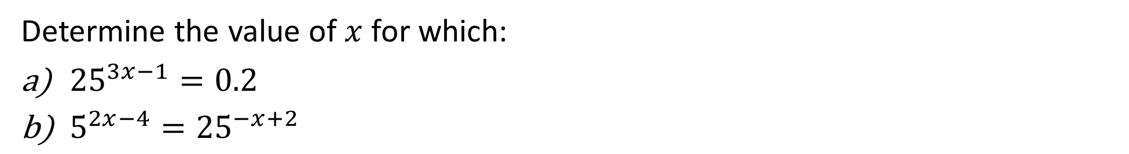

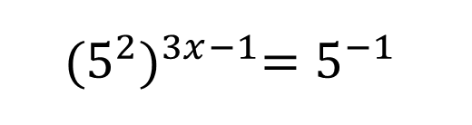


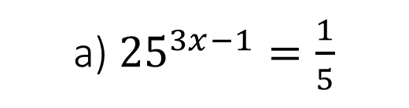

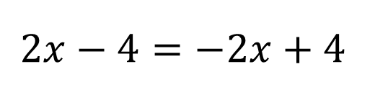
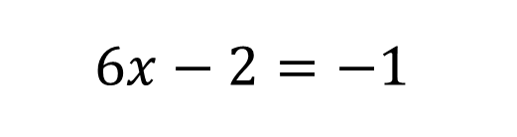
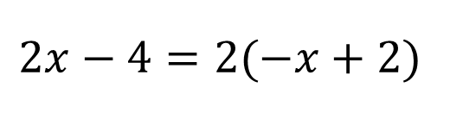
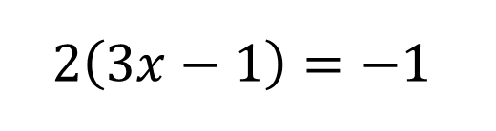
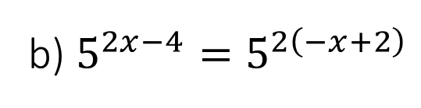
Guided Practice
Determine the value of $x$ for which:
${25}^{3x−1}=0.2$
$5^{2x−4}={25}^{−x+2}$
a) ${25}^{3x−1}=\frac{1}{5}$
b) $5^{2x−4}=5^{2\left(−x+2\right)}$
$$2x−4=2(−x+2)$$
$${(5^{2})}^{3x−1}=5^{−1}$$
$$2x−4=−2x+4$$
$$2\left(3x−1\right)=−1$$
$$4x=8$$
$$6x−2=−1$$
$$x=2$$
$$6x=1$$
$$x=\frac{1}{6}$$

Slide 6
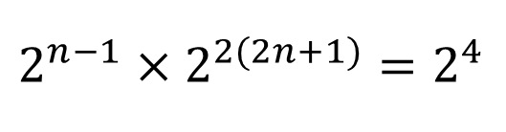

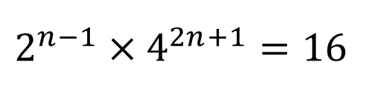

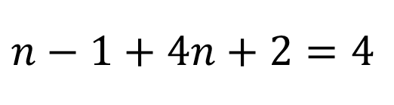
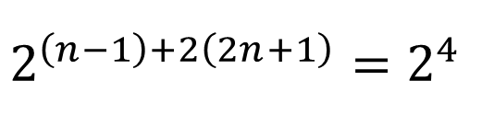
Guided Practice
Determine the value of $n$ for which:
$$2^{n−1}×4^{2n+1}=16$$
$$2^{n−1}×4^{2n+1}=16$$
$$2^{n−1}×2^{2(2n+1)}=2^{4}$$
$$2^{\left(n−1\right)+2\left(2n+1\right)}=2^{4}$$
$$n−1+4n+2=4$$
$$5n=3$$
$$n=\frac{3}{5}$$

Slide 7
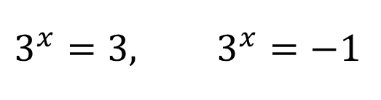

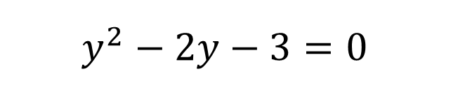
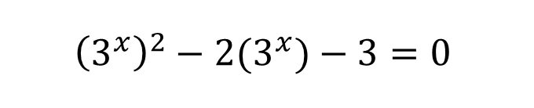
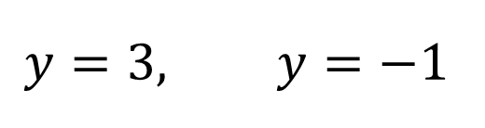
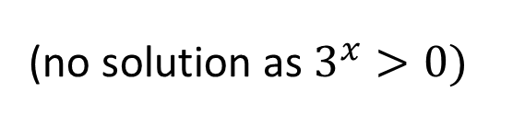
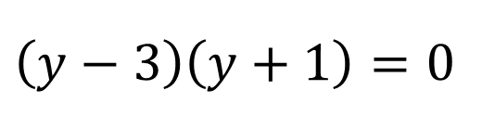

Guided Practice
Determine the value of $x$ for which:
$$3^{2x}−2\left(3^{x}\right)−3=0$$
$${\left(3^{x}\right)}^{2}−2(3^{x})−3=0$$
Let ${y=3}^{x}$
$$y^{2}−2y−3=0$$
$$\left(y−3\right)\left(y+1\right)=0$$
$$y=3, y=−1$$
$$3^{x}=3, 3^{x}=−1$$
(no solution as $3^{x}>0)$
$$x=1$$

Slide 8
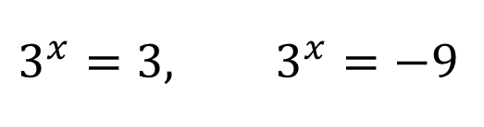
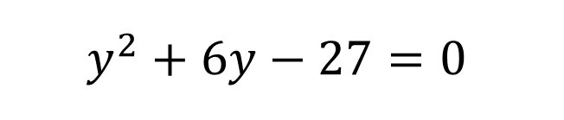
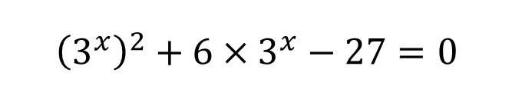
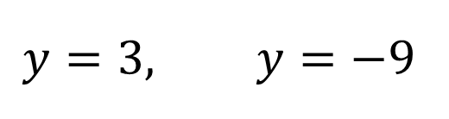
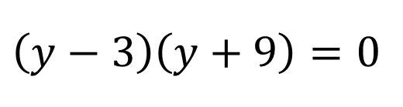
Guided Practice
Determine the value of $x$ for which:
$$3^{2x}=27−6×3^{x}$$
$${\left(3^{x}\right)}^{2}+6×3^{x}−27=0$$
Let ${y=3}^{x}$
$$y^{2}+6y−27=0$$
$$\left(y−3\right)\left(y+9\right)=0$$
$$y=3, y=−9$$
$$3^{x}=3, 3^{x}=−9$$
(no solution as $3^{x}>0)$
$$x=1$$

Slide 9
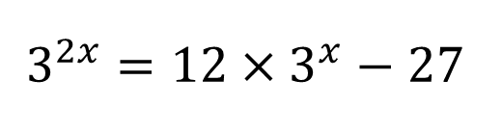
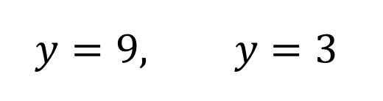
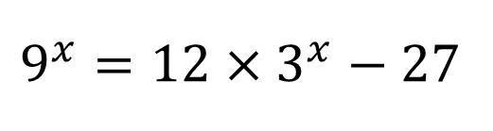
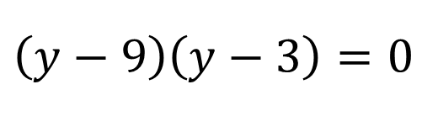
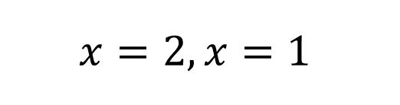

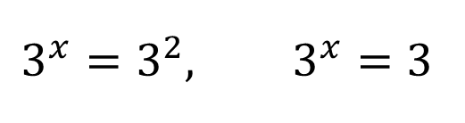
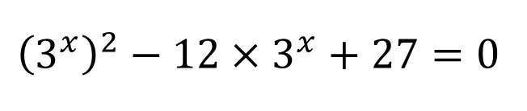
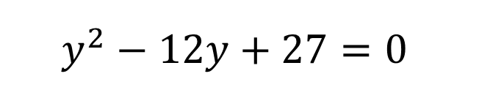
Guided Practice
Determine the value of $x$ for which:
$$9^{x}=12×3^{x}−27$$
$$9^{x}=12×3^{x}−27$$
$$3^{2x}=12×3^{x}−27$$
$${\left(3^{x}\right)}^{2}−12×3^{x}+27=0$$
Let ${y=3}^{x}$
$$y^{2}−12y+27=0$$
$$\left(y−9\right)\left(y−3\right)=0$$
$$y=9, y=3$$
$$3^{x}=3^{2}, 3^{x}=3$$
$$x=2, x=1$$

Slide 10
Independent Practice
Cambridge Ex 2C

